Slide 1

Weather Application — API Integration
Submitted by Ardra Rajesh
CODEVEDX Python Internship
B.Tech CSE
02 July 2026

Slide 2

Why this matters
Accessible, accurate weather data helps people plan travel, outdoor activities, and daily routines. This Python console app retrieves live weather via OpenWeatherMap and can run offline via a Mock Mode for demos and testing.

Slide 3

Core Objectives
Build the App
API Integration
Offline Mock Mode
Develop a Python weather application.
Connect to OpenWeatherMap for real-time data.
Provide built-in data for >60 Indian cities and international locations.
Persistence & Logging
Maintain search history (JSON) and application logs.

Slide 4




Key Features
Real-Time Weather
Offline Mock Mode
Search History
Unit Switching
Persistent JSON storage of previous queries across sessions.
Toggle between Celsius and Fahrenheit; values update automatically.
City, country, temperature, feels-like, humidity, wind speed, condition, retrieval timestamp.
Works without internet or API key using built-in dataset for testing and demos.

Slide 5

Technologies & Modules
Python 3 · OpenWeatherMap API · JSON · VS Code · Git · GitHub
urllib.request / urllib.error / urllib.parse
json, logging, datetime, os, sys

Slide 6

Project Workflow
Start
Select Source
Fetch Data
Menu
Enter City
The console follows a menu-driven flow enabling Mock or Live modes, city lookup, result display, and persistent history.

Slide 7

Project Structure
weather_app.py
Main application logic (API, parsing, controller, display).
weather_history.json
Persistent search history storage.
weather_app.log
Event logging with timestamps for debugging and audit.

Slide 8
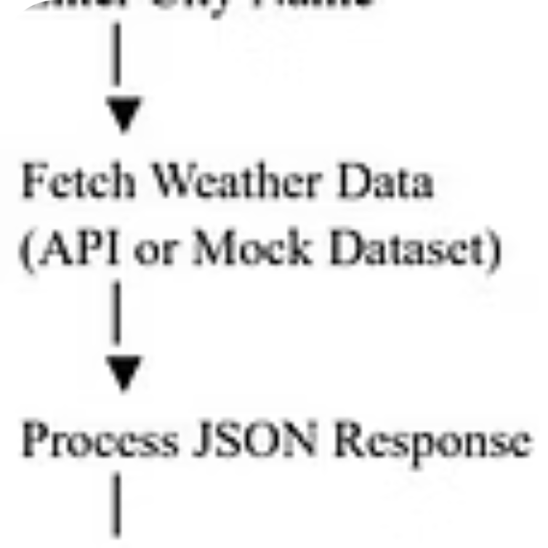
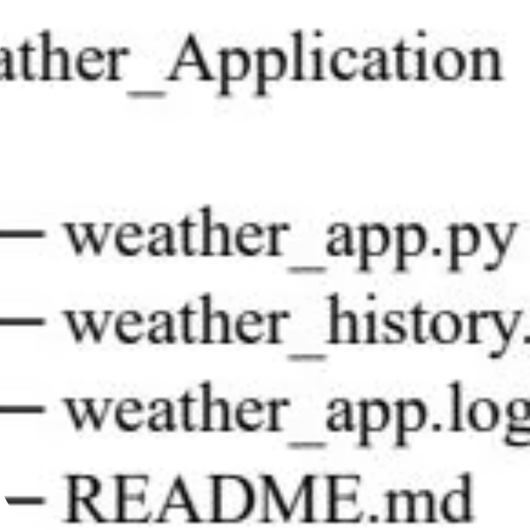
Screenshots & Sample Output
Sample console outputs show menu, a Bengaluru weather report (24.6°C), unit switches, data-source toggles, and saved history entries.

Slide 9

Error Handling & Reliability
Validated Scenarios
Empty city names, invalid API keys, city not found, network failures, timeouts, invalid API responses, corrupted/missing history files, invalid menu input, keyboard interrupts.
Resilience
Mock Mode ensures functionality without network or API key; logs assist debugging.

Slide 10


Future Enhancements & Conclusion
Conclusion: The project strengthened API integration, JSON processing, modular programming, logging, and exception handling skills. Offline Mock Mode, live retrieval, history management, unit switching, and logging made the app practical for learning and demos.
Code & dataset are ideal next steps for GUI or web deployment.
5‑ and 7‑day forecasts
GPS-based search
Multiple weather providers
Export history to CSV/Excel
Weather charts and GUI (Tkinter)
Web app (Flask/Django) & mobile support
Voice-based search

